Slide 1
Geometry and Measures
KAZIBA STEPHEN
30TH AUGUST 2024

Slide 2
Topics
Geometric Constructions Skills
Bearings
General and angle properties of geometric figures
Reflection
Business mathematics
Time and time tables
Similarities and enlargement
Circles
Rotation
Length and area properties of two- dimensional geometrical figures.
Nets, areas and volumes of solids
Trigonometry
Vectors
Matrix transformations
Circle properties
Lines and planes in three dimensions

Slide 3
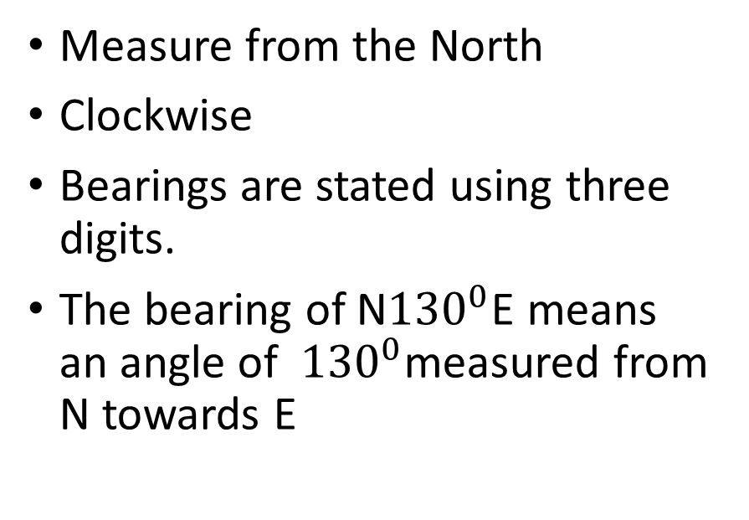
Bearings
THINGS TO REMEMBER
Measure from the North
Clockwise
Bearings are stated using three digits.
The bearing of N${130}^{0}$E means an angle of ${130}^{0}$measured from N towards E

Slide 4
Time and time tables
Recall
One hour = 60 minutes
Three quarters of an hour = 45 minutes
Half an hour = 30 minutes
Quarter of an hour = 15 minutes
One minute = 60 seconds
One hour = 3600 seconds

Slide 5
12−hour and 24−hour Clocks
The 12−hour clock notation uses am and pm to indicate morning and afternoon respectively.
am is the time from 12 midnight and before 12 noon.
pm is the time from 12 midday and before 12 midnight.
The 24−hour clock uses the numbers 00 : 00 to 23 : 59 (midnight is 00 : 00)
In the 24 hour clock, there are no 'am' and 'pm' labels.
The hours start at zero and go through to 23.
All 24 hour clock times should be written hh:mm or hh:mm:ss, where h is the hour, m is the minute and s is the seconds
Sometimes the colons are omitted between the hours and minutes.
The minutes and seconds never change when changing between 24 hour and 12 hour times.

Slide 6
Focal Areas
Compass – Arrows & Letter
Distance with correct units
Scale conversion
Sketch drawing
Heading/Title
Accuracy – Distance & Angle to at most 1d.p with units
Angle Measurements
Conclusion – Distance converted to original units –Show the conversion

Slide 9
Take Note
Correct Reference Point
Accuracy in Measurement
Direction of Measurement
Format of Bearing Notation
Clear Indication of Direction Changes
Clarity in Diagrams
Use Scale carefully

Slide 10
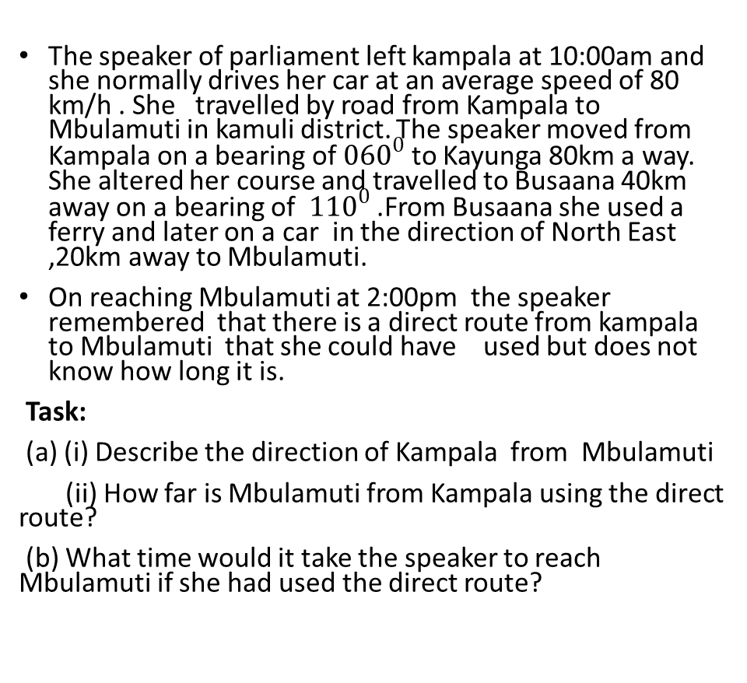
Activity
The speaker of parliament left kampala at 10:00am and she normally drives her car at an average speed of 80 km/h . She travelled by road from Kampala to Mbulamuti in kamuli district. The speaker moved from Kampala on a bearing of ${060}^{0}$ to Kayunga 80km a way. She altered her course and travelled to Busaana 40km away on a bearing of ${110}^{0}$ .From Busaana she used a ferry and later on a car in the direction of North East ,20km away to Mbulamuti.
On reaching Mbulamuti at 2:00pm the speaker remembered that there is a direct route from kampala to Mbulamuti that she could have used but does not know how long it is.
Task:
(a) (i) Describe the direction of Kampala from Mbulamuti
(ii) How far is Mbulamuti from Kampala using the direct route?
(b) What time would it take the speaker to reach Mbulamuti if she had used the direct route?

Slide 13
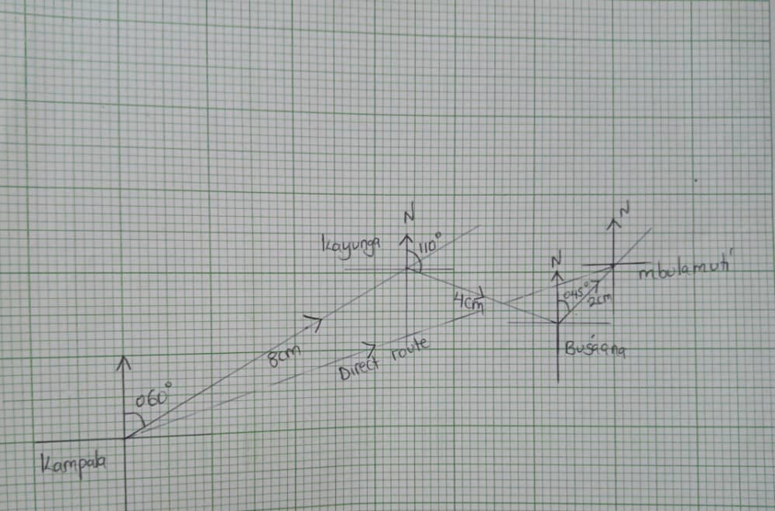

Slide 14
Activity
Pamela is a business lady who collects merchandise from a certain town A to town D using a speed boat. Because of a very big island between the towns A and D, she can not move directly to town D. S he instead travels south east to town B at a speed of 40 km/h for 5 hours. From town B, she moves at a speed of 50 km/h due East for 8 hours to town C. She then maintains this speed for another 6 hours having turned through 120° to the left until she reaches town. D
TASK:
(a). Draw a suitable diagram to show her journey
(b) Determine the distance and direction of A from D if there were a direct route.
(c) How long would it take a helicopter moving at an average speed of 200 km/h along the direct route. (Give your answer in hours and minutes)

Slide 17
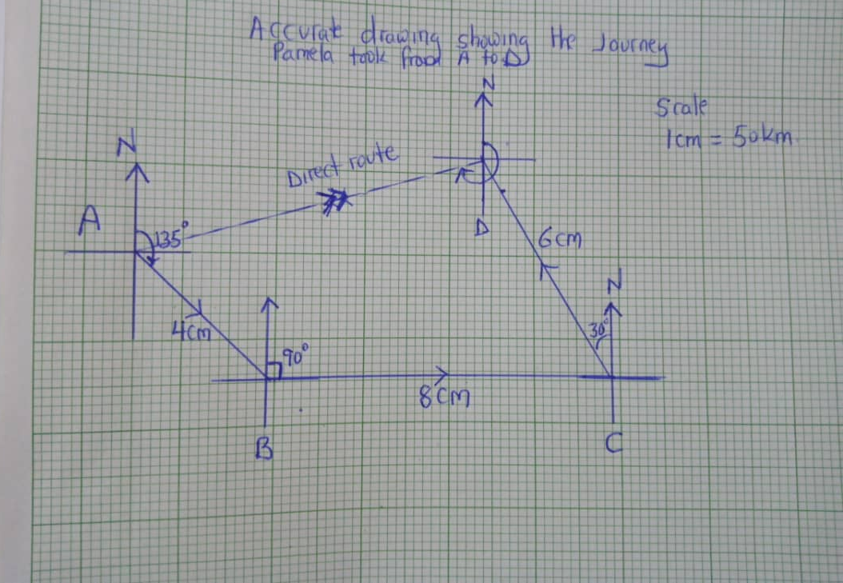

Slide 18
In a bid to reduce malaria infections on Islands, the Ministry of Health supplies mosquito nets to these Islands. A skipper is to distribute mosquito nets to three islands. He normally moves at an average speed of 60km/hr. it takes him 20 minutes to offload the package at each island. The skipper sails from Bubembe Island at 7:00am in the north eastern direction and arrives at Damba Island at 8:30am. Immediately after offloading the skipper sails east of Damba and reaches Koome Island at 9:30am, after another offload, He takes southwest direction to sail to Mageta Island.
Hint: The distance between Koome and Mageta Island is 50km.
Task:
(i) Describe the direction of Mageta from Bubembe.
(ii) At what time did the ship arrive at Mageta?
(iii) Describe the direction and distance the skipper should take for a direct route from Mageta to Bubembe.

Slide 21
Your uncle has offered to drive you to your friend's birthday party. He normally drives his car at an average speed of 50 km/h, so he requests you to get directions to the party reception and the time you are supposed to be there so that you decide on when you can leave home to reach on time. You were informed that the party will start at 2:00 PM and the directions are:
- From your home, take the north eastern direction and reach the supermarket that is 20 km away.
- Then take the road that is south of the supermarket and it will take you 45 minutes to reach the junction. - From the junction, take the southwestern road and drive 25 km to reach the party reception.
On reaching the party reception using the given directions, your friend remembers that there is a direct route from your home to the reception that you could have used but does not know how long it is. Task:
(a) (i) Describe the direction of your home from the party reception.
(ii) How far is the party reception from your home using the direct route?
(b) What time would you have to leave home for you to reach the party reception on time, if you used the direct route?

